Slide 1
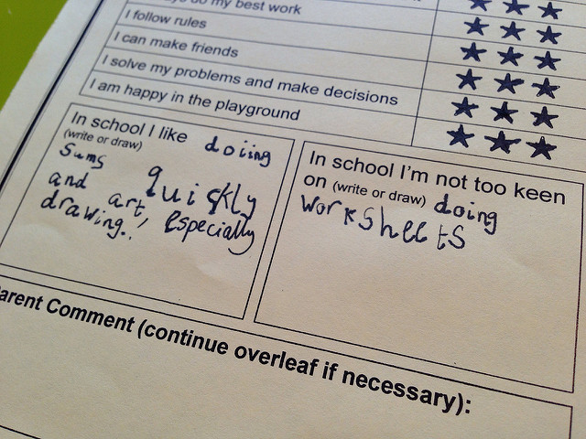
Ramp-Up your Worksheets
Toni Carter
Reference & Instruction Librarian
Auburn University Libraries
tcarter@auburn.edu
https://www.flickr.com/photos/edublogger/9116763834
https://creativecommons.org/licenses/by-nc/2.0/
Alabama Library Association Annual Convention 2017
Notes:
I’ll be sharing my experiences with trying to continuously improve in-class worksheets in order to create meaningful learning experiences. The title in the conference program is Techniques for Teaching Students Critical Thinking. I got to thinking it’s really hard to teach someone critical thinking, but rather it’s creating situations and activities in which they’re encouraged or required to think critically. So I changed my title, but I’ll still be focusing on how over the years (particularly the last year or two since the Framework came out) how I have myself thought more critically about my worksheets. I’m going to give you a little context, and then show you some before and after examples of worksheets that I’ve used in 50 or 75 minutes instruction sessions.

Slide 2
Context
Freshmen composition
General education assessment
Topic development, source evaluation, keywords/database searching
Notes:
Most of the classes I teach are freshmen composition classes (along with the other 3 members of our instruction team). Even though composition has a curriculum, some instructors interpret it differently, so we meet with each instructor beforehand to tailor the class and worksheets. We don’t have standard lesson plans or worksheets – but we really have changed our teaching since the Framework. We’re going to try over the summer to choose a few of our best examples of lesson plans and activities and put them online, giving the instructors a better sense of what we are willing to do; right now, however, every session could have a different type of activity or worksheet.
This has to do with an ongoing effort to get more library instruction into the disciplines and to shift our focus a bit. The university is revising all of our general education outcomes, including information literacy. And, instead of course-embedded assessment within the core, we’ll now be assessing at the end of four years. So we want presence both in composition and the disciplines. We don’t have more people, so we have to make cuts somewhere.
We’re trying to take more control of our curriculum, and this past semester we cut our sessions down for composition from two to one.
W cover either topic development or source evaluation – depending on when in the semester they scheduled; we put keywording and searching a general database online.

Slide 3
Considerations when using worksheets
Relevancy
Learning outcomes
Assessment
Notes:
These are sort of common-sense factors, but I think I should mention them:
Relevancy – is it relevant to the class?; is it going to help students move forward with their assignment?; if not, they will most likely see it as busy work; sometimes this means I’ll develop something directly related to the assignment, or something that covers skills that are transferable. If that’s the case, my intention is guide them towards making that connection.
Learning outcomes – does it align with the learning outcomes of the session
Assessment – I try to think how I can use the worksheet to assess student learning
What I wanted to show you today was some of the worksheets I’ve used for source evaluation, which is a broad concept (I know). I’ve been teaching these for about twelve years, and I’m still learning about what works and what doesn’t. My goal today is to share a little bit of my knowledge from my successes and failures in getting students to think beyond yes and no, or pro or con, or right or wrong when evaluating sources. I want to move them away from binary thinking to more complex, critical thinking.

Slide 4
Example 1
Information Creation as Process
Authority is Constructed and Contextual
Notes:
Frames – depending on how you discussed it, you could take it into a couple of directions
Transferable skills
Must view PowerPoint as slideshow to see before/after

Slide 5
Example 2
Information Creation as Process
Authority is Constructed and Contextual
Scholarship as Conversation
Notes:
Frames – depending on how you discussed it, you could take it into a couple of directions
Directly related to class assignment
They bring in sources they’ve already found
Must view PowerPoint as slideshow to see before/after

Slide 6
Example 3
Information Creation as Process
Authority is Constructed and Contextual
Scholarship as Conversation
Notes:
Types of sources that their assignment required
Must view PowerPoint as slideshow to see before/after

Slide 7
Thank you! Questions?
Toni Carter
tcarter@auburn.edu
@tonimcarter

