Slide 1
Implementing Click-Tracking
Auburn University Libraries
Clint Bellanger
Jeremy Goslin
Liza Weisbrod
Notes:
Today I'm going to discuss our implementation of click tracking. Some of this will get technical, especially the second half, but hopefully everyone will be able to pick up the key concepts.

Slide 2
From mouse clicks to usage reports
where to begin?
Auburn's implementation details
Notes:
In this presentation we'll explain how to create a system to get from mouse clicks to usage reports. First we're going to cover the bare minimums to capture the data, which can serve as a Phase 1 implementation for many institutions. Then we're going to get into the details of our specific implementation.

Slide 3
Inserting the tracking link
http://onlineresource.com/12345
becomes
http://institution.edu/tracking.php?
destination=http://onlineresource.com/12345
Notes:
Here's an example link that we want to track, just a simple HTML hyperlink. The way we process click tracking is by routing the user through a tracking page. Here we manipulate our links so that the tracking script is the actual link, and the desired destination is a parameter to that link. Note there are other ways to approach this: for example you could use the link's onclick event to call your tracking script instead.

Slide 4
Tracking script
tracking.php?
destination=http://onlineresource.com/12345
Save the click information to database
Forward the user to the destination page
If possible, transparent to the user (fast!)
Notes:
We have one central tracking script that performs two main functions: saves the clicks to a persistent database, and forwards the user to their desired page. This should happen fast enough that the user doesn't notice any delay between clicking a link and their destination page loading.

Slide 5
Tracking database (simplified)
URL | Time Stamp
http://onlineresource.com/12345 | 2012/05/10 11:15
Notes:
Here's a simplified view of a tracking database. At minimum you're recording the destination URL and the timestamp that represents when the click occurred. Later we'll see our actual tracking table that has more details.

Slide 6
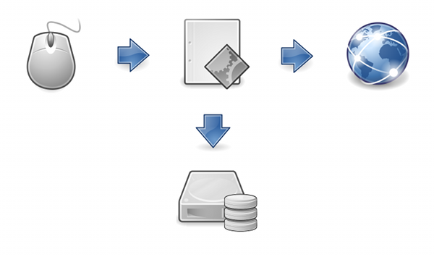
Tracking (Phase I)
Notes:
So here are the essentials. Insert your tracking script address into links you want to track. Have a tracking script that writes to database and forwards the user to a URL. And have a primitive database that holds clicks. At this point you're collecting the data, which is the most important step. If you were implementing a click tracker at your institution, this would be a sensible Phase I.

Slide 7
Tracking link with Javascript pt.1
Page difficult to edit
Prevent search engine crawling
Allow users to browse privately
Notes:
Where possible, we don't actually hardcode our tracking URL onto each link. We prefer to use javascript to inject the tracker after a page has loaded.
There are a few good reasons for this. One, the page might be difficult to edit. For example, you might not have the source code to your hosted discovery layer, but you can add javascripts as needed. Second reason, it helps to prevent search engine crawling from creating false positives on clicks. Most indexing spiders won't run javascripts when crawling a page. You could try using a nofollow directive, but not all spiders will honor it and usually you want the destination resource to be discoverable. Finally, users have a way to opt-out of tracking. By disabling javascript their clicks won't be recorded.

Slide 8
Tracking link with Javascript pt.2
Regular expressions to match links
var match = /Web Link:[^A]+A\s+HREF=[^>]+>/igm;
Find/replace to format destination URL
replace( /\?/g, "%3F" )
replace( /&amp;/g, "&" ).replace( /&/g, "%26" )
Notes:
This makes inserting the tracking link a bit trickier than before. Sometimes your links are a certain HTML class and they're easy to find, but for many situations you'll be using regular expressions to match links in your document.
Also, you'll want to format the destination URL if it has its own GET parameters. Here's an example of replacing the question mark and ampersands with character codes.

Slide 9
Tracking click sources
http://lib.auburn.edu/tracker.php?
?source=catalog
&bibId=3456789
&url=http://search.ebscohost.com/direct.asp%3Fdb=aph%26jid=5BI
Notes:
Our tracking script actually takes in more than just the destination URL. First we have a "source" value that specifies where the link came from. We use this because we're now tracking clicks from our VuFind discovery layer, our Traditional Voyager catalog view, and we plan to expand it to other systems. The second additional piece of info we track is a global unique ID. Here we're using the Bibliographic ID from our Voyager ILS. So now we're not only tracking each outgoing link, but we can trace each link back to the source of the click.

Slide 10
Detail lookup and URL validation
nightly cron process
fetch Title and Call Number from catalog
Validate URL (HTTP 200 OK)
Notes:
There are some details we want to know about the click, but aren't necessary to capture in real time. We use a nightly cron script to fetch this additional information and perform cleanup.
We use this process to lookup Title and Call Number for the resource based on the Bib ID. We probably could pass these in as additional tracking parameters instead (being careful to deal with special characters). This info is only needed when running reports, so we opted to look them up separately. We can easily expand this to bring in more detail data without making our tracking script itself more convoluted.
This is also a good time to do automated validation. We are implementing a script that simply checks the URL to see if the server gives a happy response. If not, we can mark the URL for manual review.

Slide 11
Tracking database
table clicks (
id number primary key auto-increment,
url text,
bib_id number,
click_date timestamp,
title text,
call_number text,
validation number
)
Notes:
Here's essentially what our final tracking database looks like. We use a unique internal ID as the primary key. We've also added the detail and validation information.
Our database uses MySQL, but this is simple enough that just about any database solution would work.

Slide 12
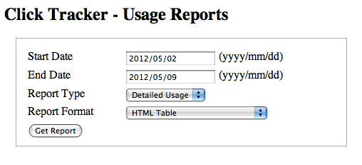
Reports
Notes:
Finally, creating reports. We have a generic database report tool that we use for several systems at Auburn University Libraries.
We can specify a date range for the data we want to see.
By default the report will show details for each click, but the report can also simply show the sum number of clicks.
The tool offers reports formatted in HTML or CSV. Comma separated values files are useful for importing into Excel.
To actually generate the reports, the PHP script takes the full database result set and formats each row element. Once the queries are built, the same basic code can generate reports for any result set.

Slide 13
Reports (save as CSV)
Apache Rewrite (.htaccess file)
RewriteEngine on
RewriteRule ^click_events.csv$ events_csv.php
Manipulate Header (.php file)
header("Content-type: application/text");
Notes:
For outputting CSV files, we trick the user's browser into thinking our PHP script is actually a CSV file.
First we use Apache Rewrite so that the URL looks like a CSV file, but on the server it's actually our PHP file.
Second, at the beginning of that PHP file we use this command that manipulates the HTML response header. So instead of displaying the raw CSV data in the browser, it will instead try to open the file in an appropriate app (such as Excel).

Slide 14
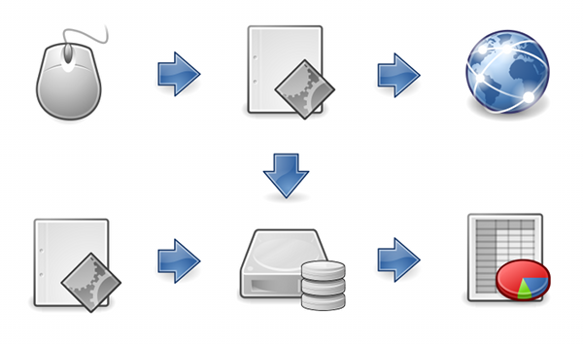
Click Tracking Diagram
Notes:
And here's the final diagram of our click tracker.
We use javascript to inject our tracking page. When the user clicks, the tracking script saves the click to database and forwards the user to the destination web site. A nightly process looks up additional details per click and performs validation. A reporting tool pulls from the database and displays data in tabular formats.

Slide 15
Tech Questions?
Clint Bellanger cpb0001@auburn.edu
Source available upon request (GPL)
Credits:
Diagram icons via openclipart.org (public domain)
Notes:
Questions? Comments?
We don't have the source in a public repo yet but we're working on that. For now we can supply the source upon request. Feel free to contact me for the source or for questions about setting up your own click tracker.

